Slide 1
ANDROID
Sec:7
Eng:Rasha Sleem

Slide 2
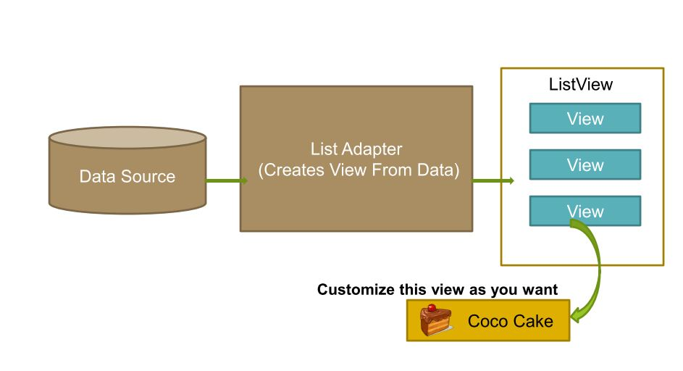
List View
List View is a view group that displays a list of scrollable items.
The list items are automatically inserted to the list using an Adapter

Slide 3
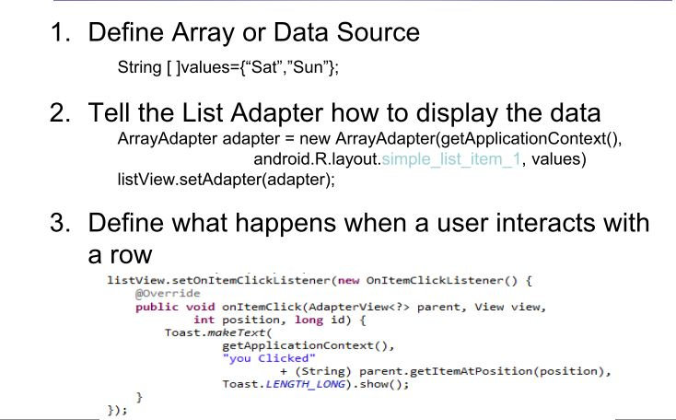
Create simple List View

Slide 4
How to create custom adapter?
1. Create class that extends ArrayAdapter.
2. Define constructor that calls one of the predefined superclass constructor.
3. Override getView() method.

Slide 5
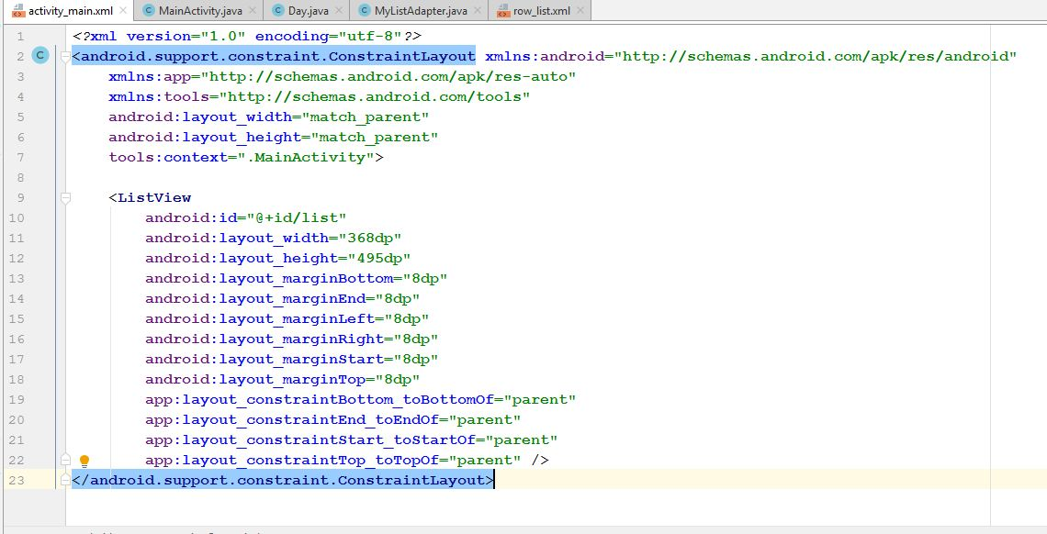
activity_main.xml

Slide 6
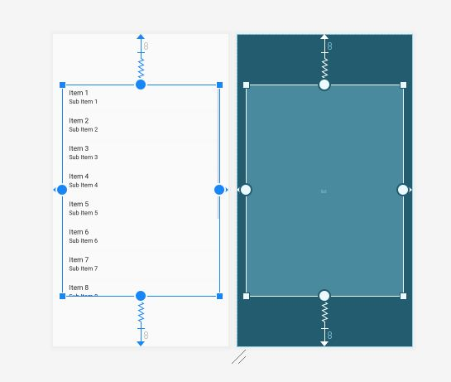

Slide 7
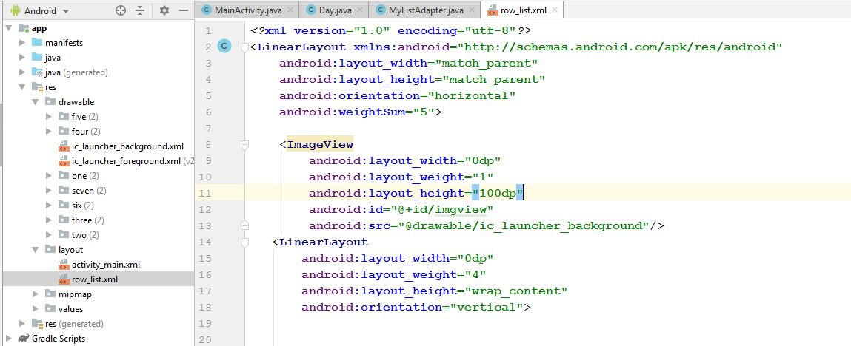
row_list.xml

Slide 8
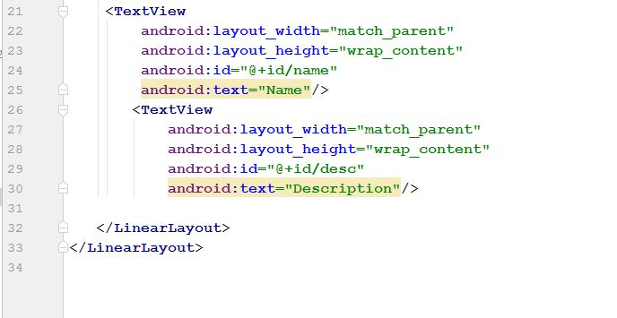

Slide 9
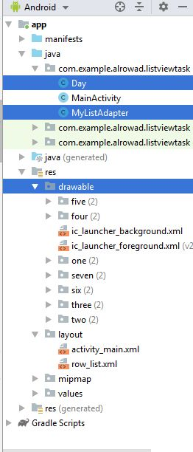

Slide 10
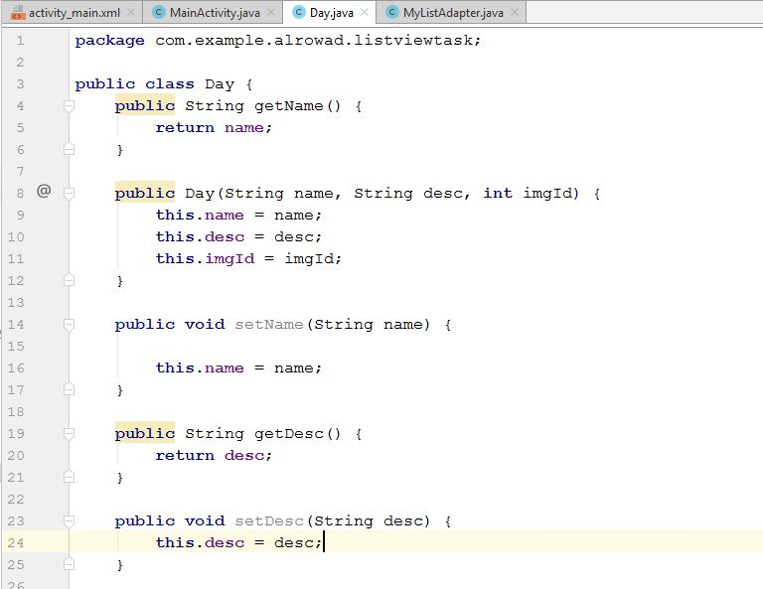
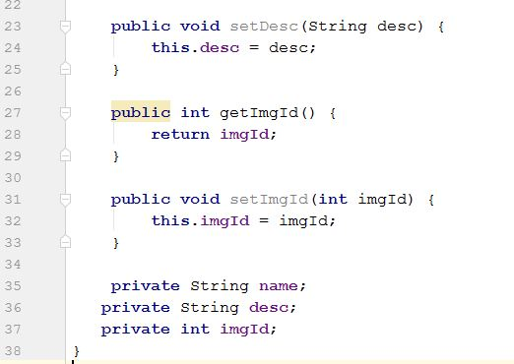
Day.java

Slide 11
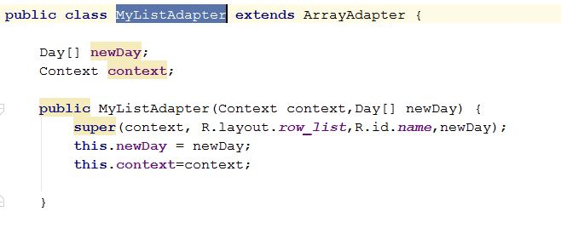
MyListAdapter.java

Slide 12
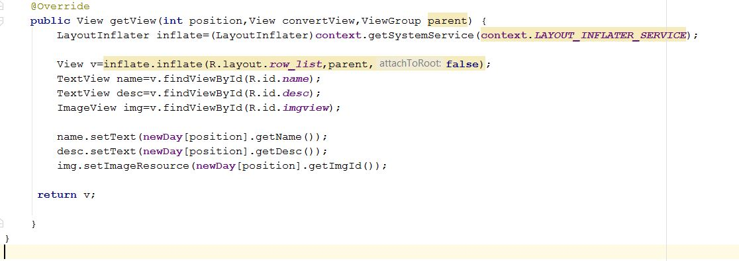

Slide 13
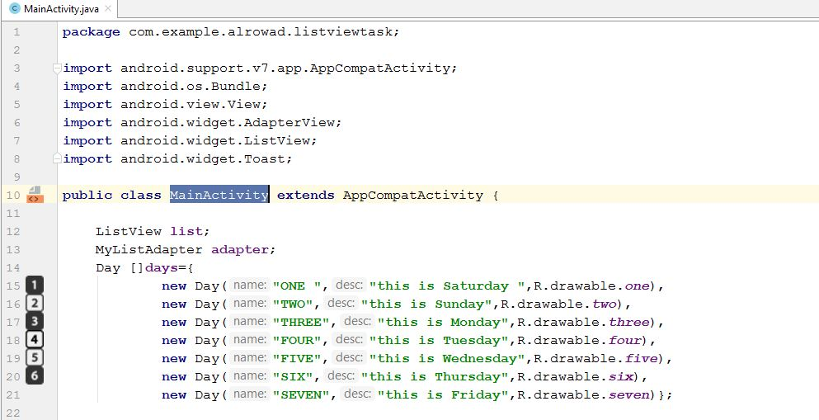
MainActivity.java

Slide 14
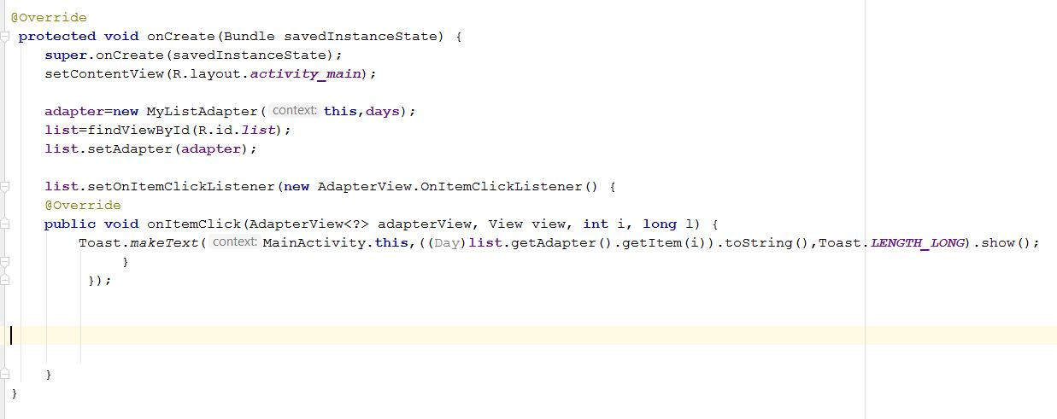

Slide 15
